Slide 1
Android Application Development (I)
Practice – Design Reference

Slide 2
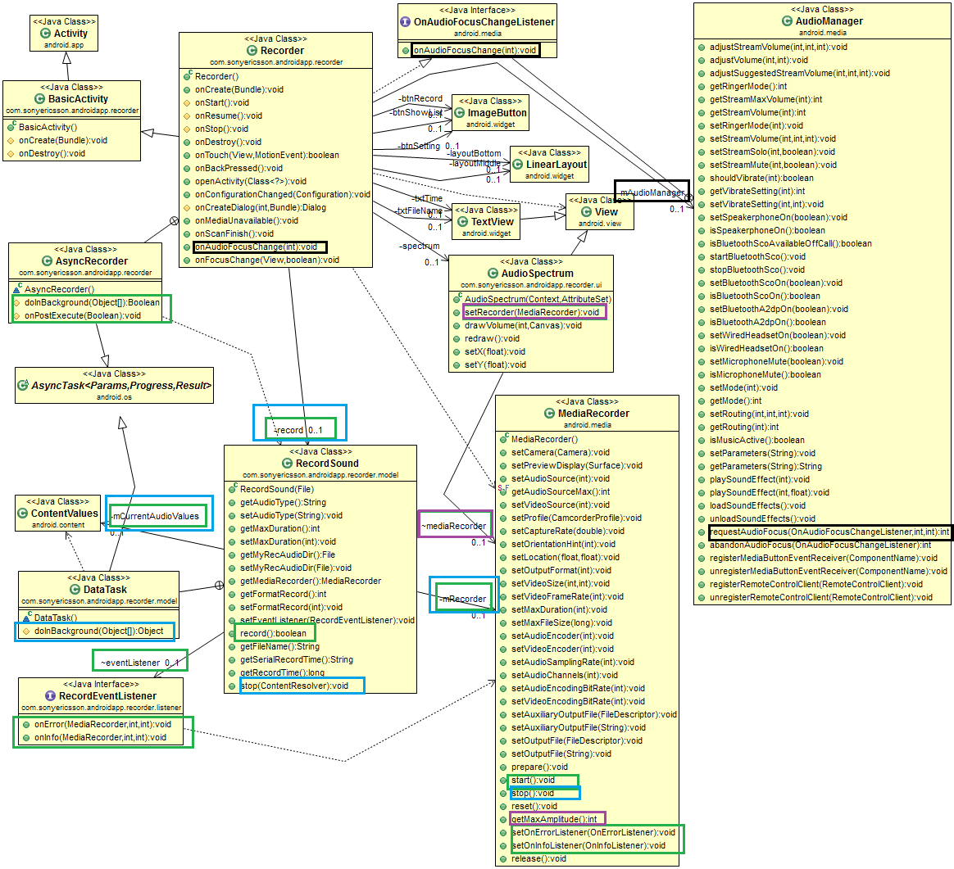
Design (Class Diagram) – Record
Black: Get system service - Audio Manager
Green: Start audio recording
Blue: Stop audio recording
Purple: Draw Spectrum

Slide 3
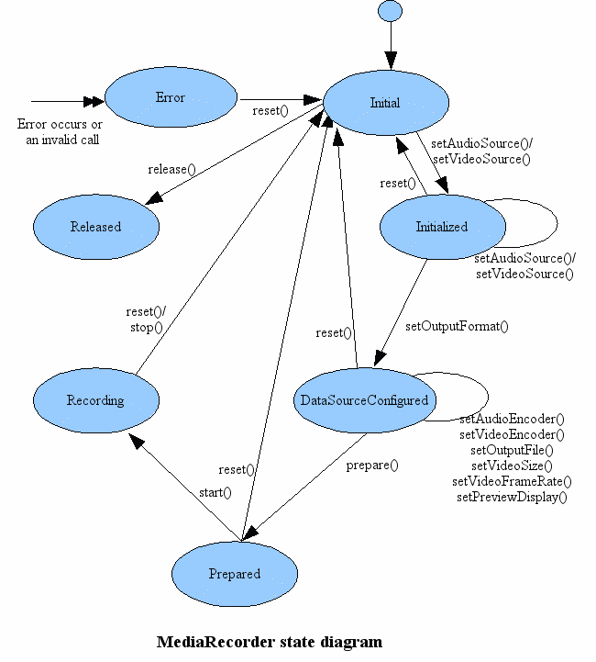
Design (MediaRecorder State Diagram)

Slide 4
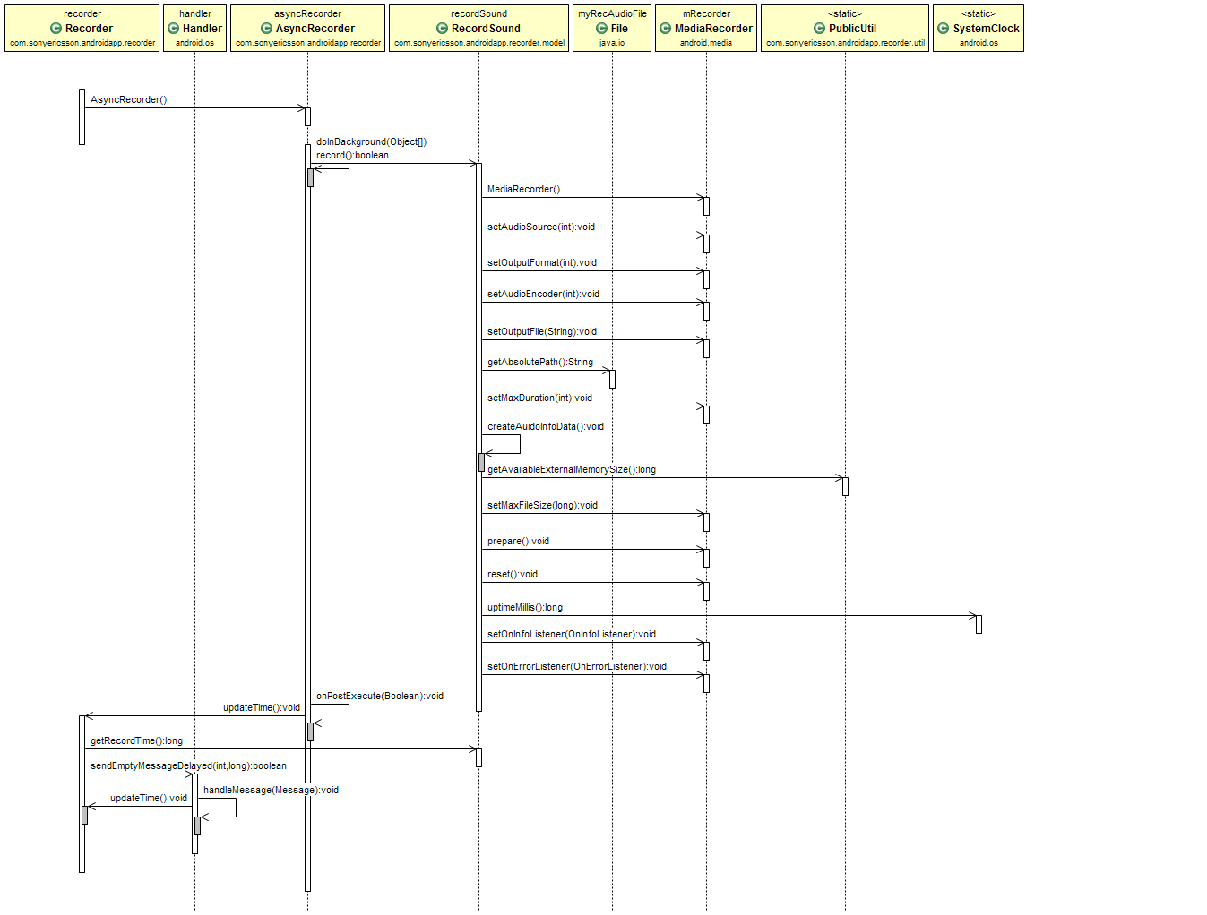
Design (Sequence Diagram) – Record

Slide 5
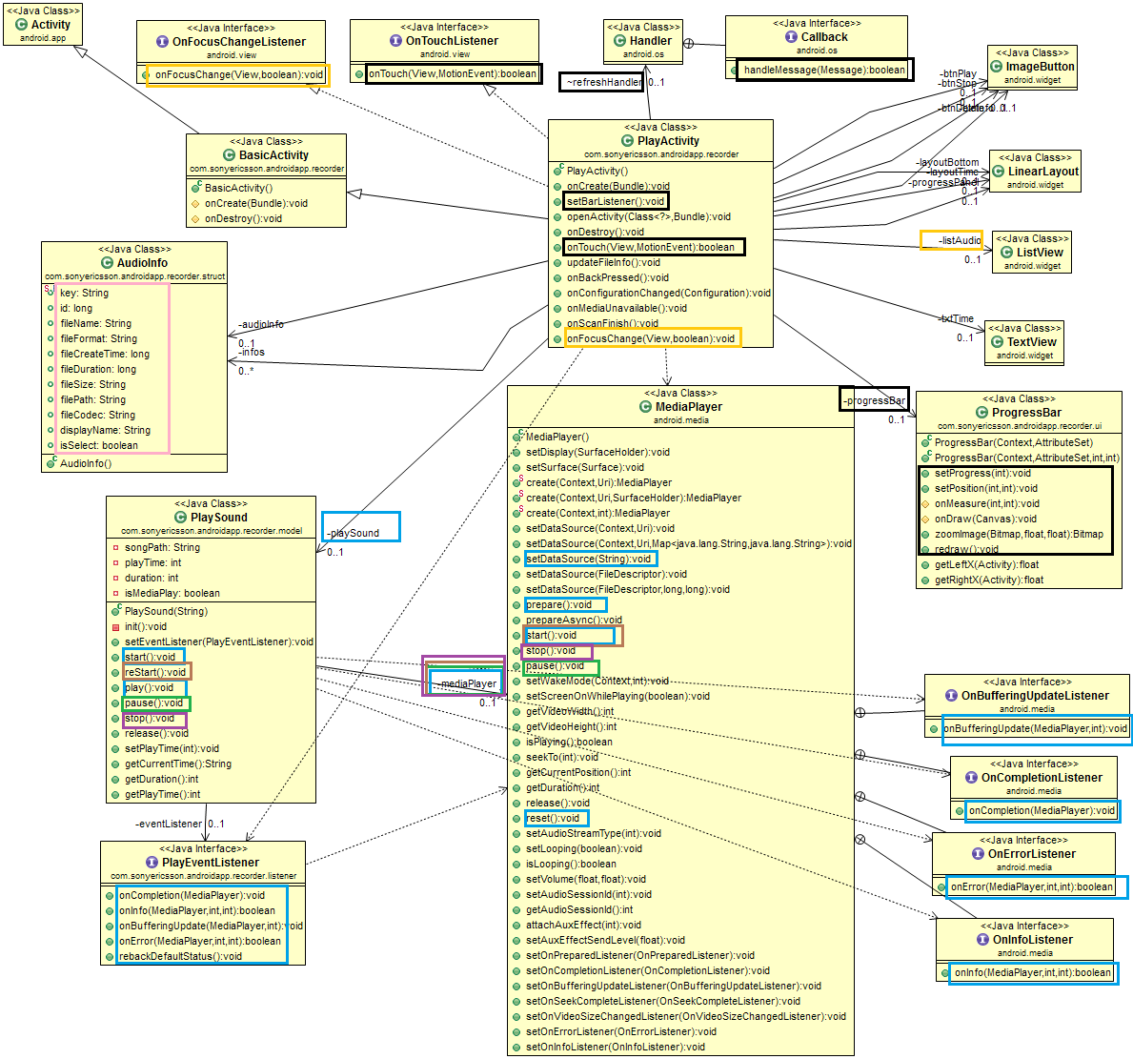
Design (Class Diagram) – Play
Black: Control progress bar
Yellow: Control list view
Pink: The structure of audio file
Blue: Start sound play
Green: Pause sound play
Brown: Restart sound play
Purple: Stop sound play

Slide 6
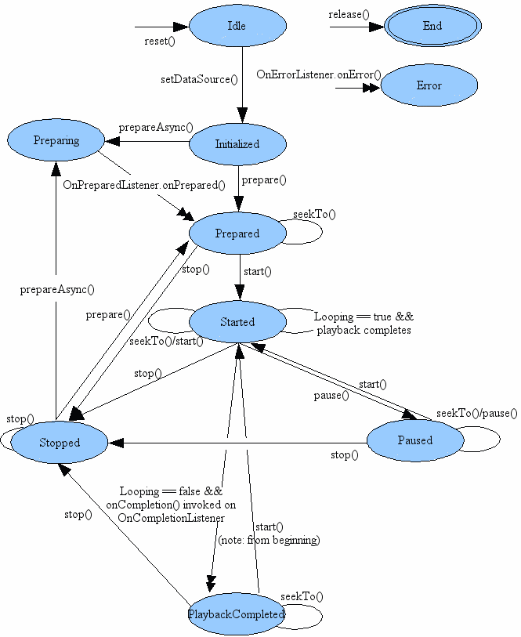
Design (MediaPlayer State Diagram)

Slide 7
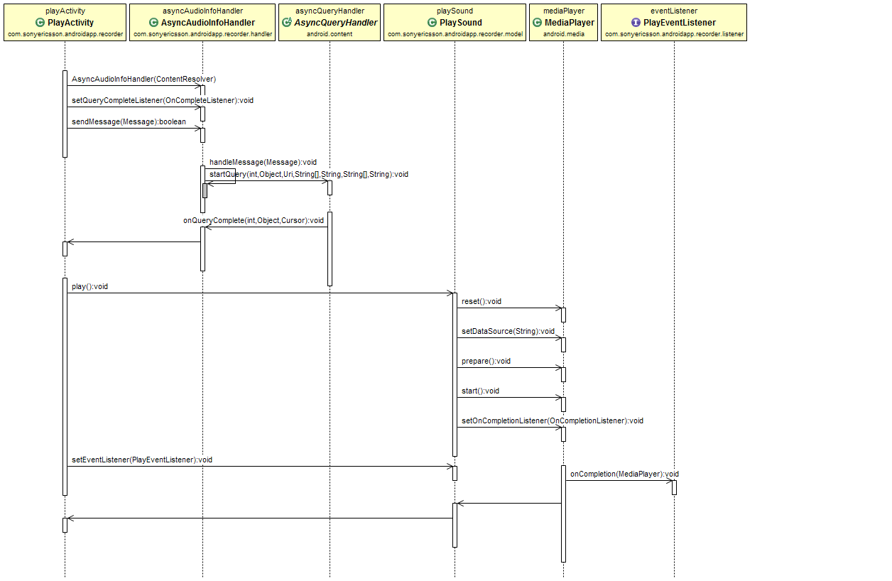
Design (Sequence Diagram) – Play

